Slide 1
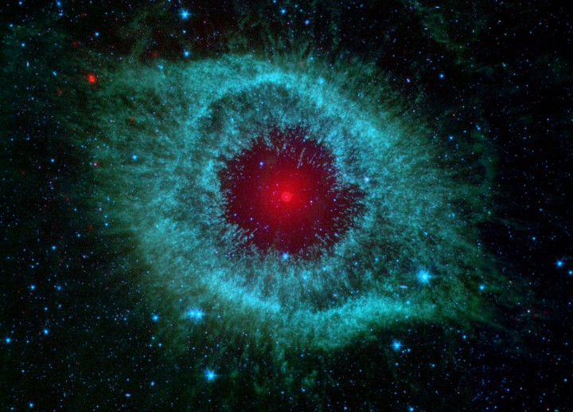
Introducing and Defining the Concept of a Worldview
Session 1
Dr. Lewis Winkler • East Asia School of Theology (Singapore) Uploaded by Dr. Rick Griffith • Jordan Evangelical Theological Seminary Files in many languages for free download at BibleStudyDownloads.org

Slide 2
Christine, Me, Josh, Barbara, and Bethany

Slide 3
Where are we headed in this class?

Slide 4
Where are we headed in this class?
What is a “worldview”?
The Potential Problem of a Sight-oriented Bias:

Slide 5
Where are we headed in this class?
What is a “worldview”?
The Potential Problem of a Sight-oriented Bias:
A Working Definition:

Slide 6
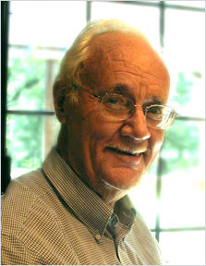
[A worldview represents] ‘the fundamental cognitive, affective, and evaluative presuppositions a group of people make about the nature of things, and which they use to order their lives.’ Worldviews are what people in a community take as given realities, the maps they have of reality that they use for living.
Paul G. Hiebert, Transforming Worldviews, 15

Slide 7
Highlighting Key Elements in This Definition:
Cognitive:

Slide 8
Highlighting Key Elements in This Definition:
Cognitive:
Affective:

Slide 9
Highlighting Key Elements in This Definition:
Cognitive:
Affective:
Evaluative:

Slide 10
Highlighting Key Elements in This Definition:
Cognitive:
Affective:
Evaluative:
Presuppositions:

Slide 11
Highlighting Key Elements in This Definition:
Cognitive:
Affective:
Evaluative:
Presuppositions:
Community:

Slide 12
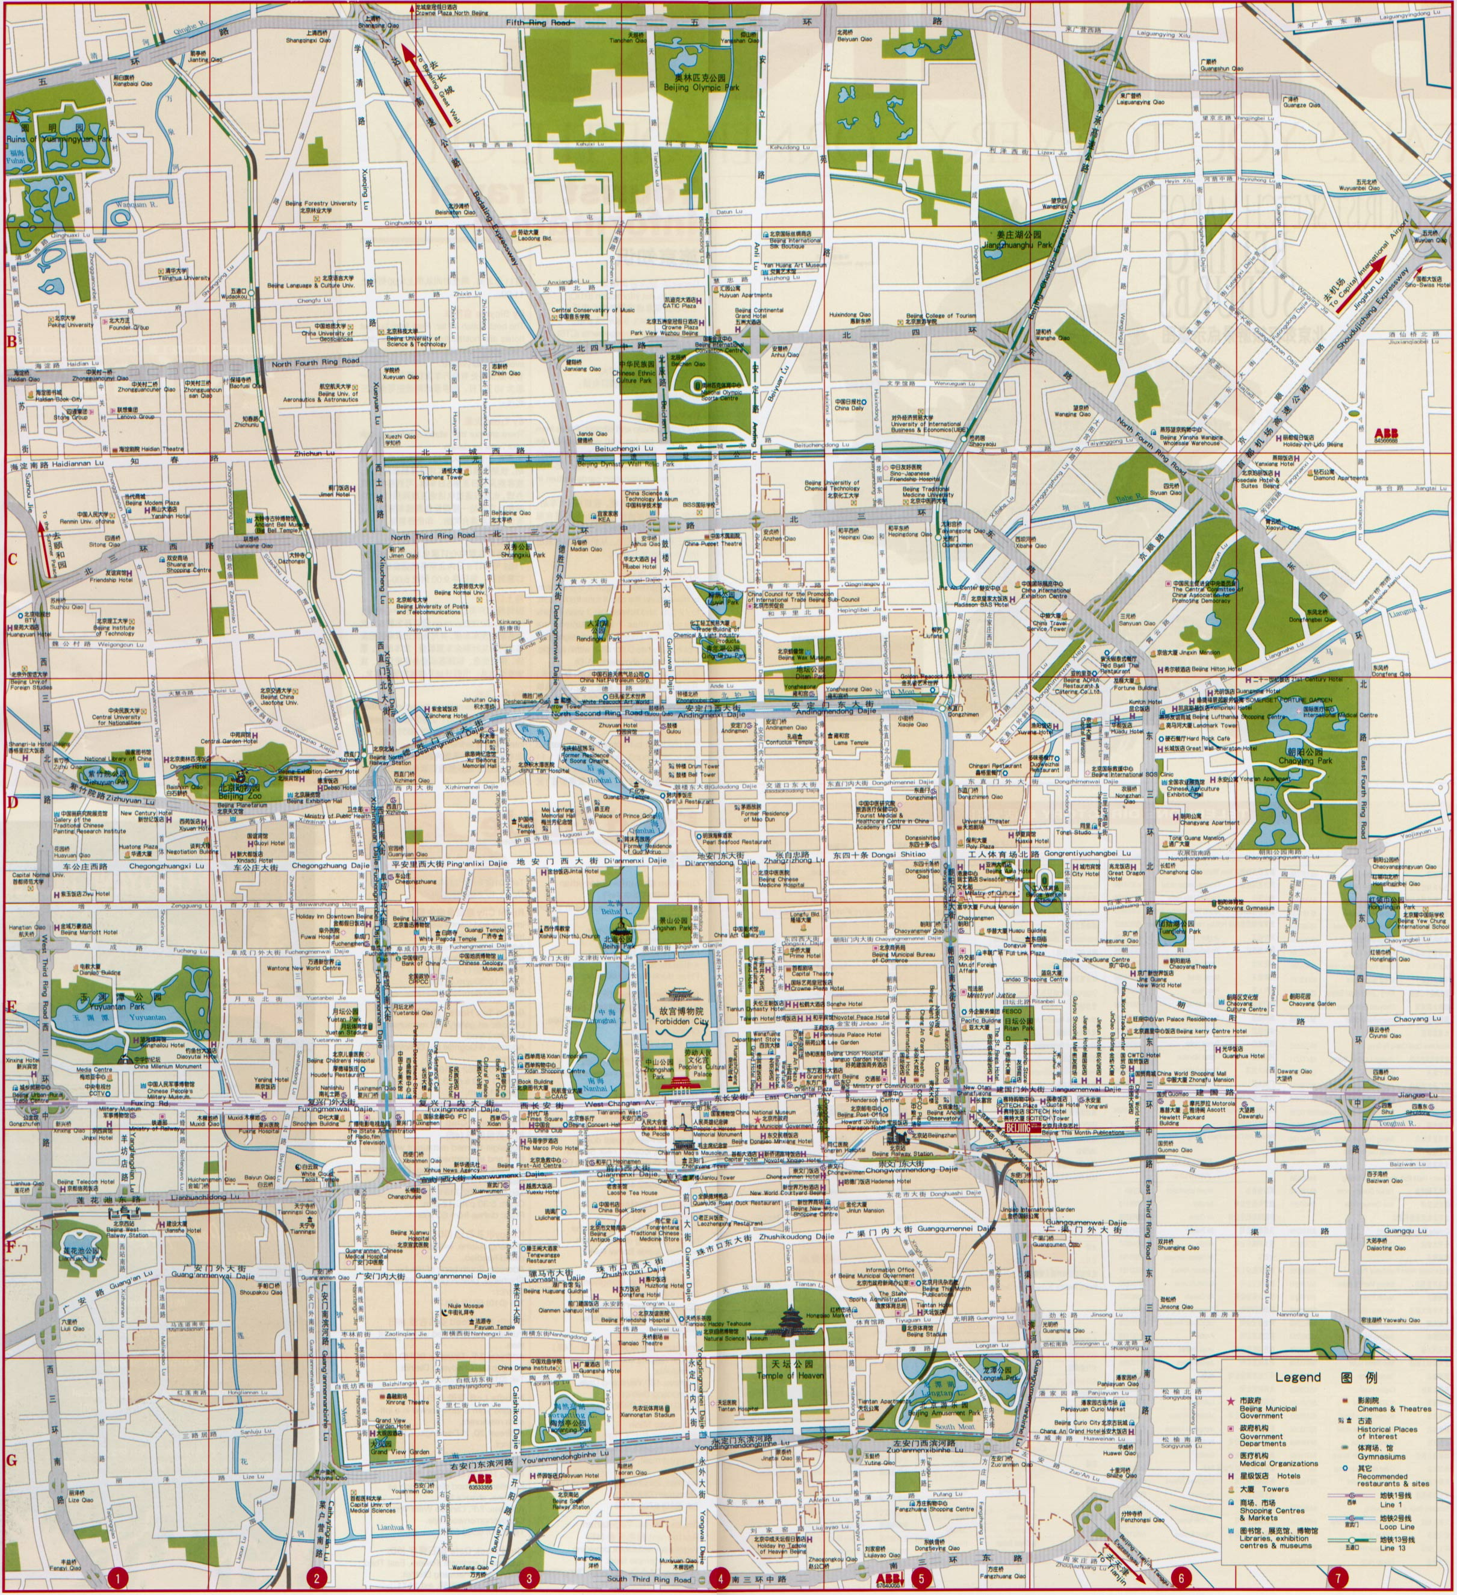
Highlighting Key Elements in This Definition:
Cognitive:
Affective:
Evaluative:
Presuppositions:
Community:
A “Map” for Living:

Slide 13
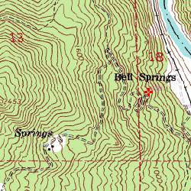

Slide 14
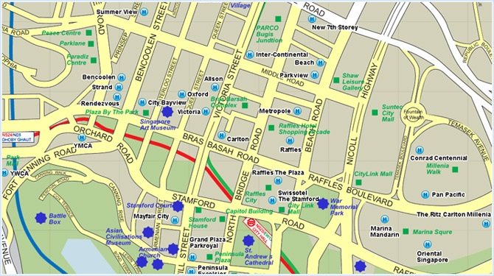

Slide 15
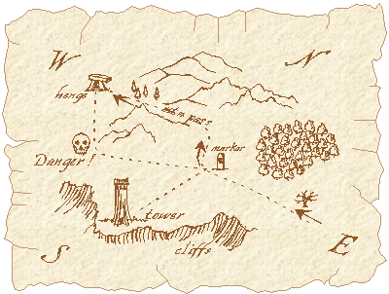

Slide 16
What This Class Can and Cannot Accomplish:
Comprehension versus Comprehensive:

Slide 17
What This Class Can and Cannot Accomplish:
Comprehension versus Comprehensive:
Journey versus Arrival:

Slide 18
What This Class Can and Cannot Accomplish:
Comprehension versus Comprehensive:
Journey versus Arrival:
Trajectory versus Perfection:

Slide 19
The Relationship Between Religions and Worldviews: Preliminary Perspectives:
When can we call a religion a worldview?

Slide 20
The Relationship Between Religions and Worldviews: Preliminary Perspectives:
When can we call a religion a worldview?
The Reality of Additional Worldview-shaping Factors:

Slide 21
The Relationship Between Religions and Worldviews: Preliminary Perspectives:
When can we call a religion a worldview?
The Reality of Additional Worldview-shaping Factors:
Venn Diagrams to Help Illustrate Some Possible Relationships:

Slide 22
Some Possible Examples of the Relationships between Culture, Personal Perspectives, and a Biblical Worldview Using Venn Diagrams

Slide 23
Contemporary Culture
Personal Perspectives
Biblical Worldview
Biblical Convergence and Common Ground

Slide 24
A Possible Global Worker (depending on the nature of the host culture)
Contemporary Culture
Personal Perspectives
Biblical Worldview
Biblical Convergence and Common Ground

Slide 25
Contemporary Culture
Personal Perspectives
Biblical Worldview
Someone from a Biblically-influenced Culture (But Not Necessarily a Christian)
Biblical Convergence and Common Ground

Slide 26
Someone from a Non-biblically-influenced Culture (Who is Probably Not a Christian)
Contemporary Culture
Personal Perspectives
Biblical Worldview
Biblical Convergence and Common Ground

Slide 27
A Growing Christian Who Lives in a Non-biblically-influenced Culture
Contemporary Culture
Personal Perspectives
Biblical Worldview
Biblical Convergence and Common Ground

Slide 28
Contemporary Culture
Personal Perspectives
Biblical Worldview
This person is from a non-biblically-influenced culture and is not only likely not a Christian, but is also largely a cultural outsider.
Biblical Convergence and Common Ground

Slide 29
The ultimate goal is to bring one’s personal perspectives increasingly into conformity with a biblical worldview while at the same time influencing and impacting the surrounding cultural spheres for God’s greater glory so that, hopefully and prayerfully, the culture moves toward greater conformity with a biblical worldview.

Slide 30
Conclusion and Application: The Graphic Organizer

Slide 31
Worldview and Biblical Decision Making
Graphic Organizer

Slide 32
The Basic Tools of Human Rationality and Personality, Raw Sense Data, and Cultural Inheritance

Slide 33
What is done?
What is good?
What is true?
What is real?
My/Our Story
(The CORE Narrative(s))
Worldview
Metaphysics
Beliefs/Knowledge (Epistemology)
Values (Ethics)
Behavior (Sociology)

Slide 34
5 Key Questions for a Worldview Narrative
5 Key Components of a Worldview
Who are we?
What is wrong?
What is the remedy?
What time is it?
Where are we?
What is done?
What is good?
What is true?
What is real?
4 Key Themes of the Biblical Narrative
Creation, Fall, Redemption, Culmination
Realignment and Convergence
My/Our Story
(The CORE Narrative(s))
Worldview
8 Key Steps for Making Biblical Decisions
Gather facts from the Bible, culture, specific situation, etc.
Determine competing values.
Identify the moral principles.
List the alternatives.
Compare the moral principles with each alternative.
Evaluate the consequences.
Get godly input.
Make a prayerful decision.
Metaphysics
Repent, Reprogram, and Reform
Beliefs/Knowledge (Epistemology)
Values (Ethics)
Behavior (Sociology)
4 Key Criteria for Christian Worldview Evaluation
Does it adequately represent reality?
Does it explain what it claims to explain?
Is it subjectively satisfying?
Does it coincide with a biblical worldview?

Slide 35
Attributions
Bartholomew, Craig G. and Michael W. Goheen. The Drama of Scripture: Finding Our Place in the Biblical Story. Grand Rapids: Baker Academic, 2004.
Hiebert, Paul G. Transforming Worldviews: An Anthropological Understanding of How People Change. Grand Rapids: Baker Academic, 2008.
Hollinger, Dennis P. Choosing the Good: Christian Ethics in a Complex World. Grand Rapids: Baker Academic, 2002.
Rae, Scott B. Moral Choices: An Introduction to Ethics. 3 ed. Grand Rapids: Zondervan Publishers, 2009
Sire, James W. The Universe Next Door, 5th Edition. Downers Grove, IL: InterVarsity Press, 2009.

Slide 36
The process of realignment and convergence with a biblical worldview includes at least three key elements:
Repentance
Reprogramming
Reforming
With God’s help, these three elements enable the person to increasingly understand, embrace, and live out a Christian worldview so that God is glorified and the culture around them can be biblically influenced in the process.

Slide 37
Repentance
This involves the realization and admission of sinful thought patterns, values, and actions.
It also involves the forsaking of those sinful beliefs and habit patterns and a humble willingness to surrender to God’s will, trusting Him to bring about sustained life transformation.

Slide 38
Reprogramming
This involves the active reprogramming of thought patterns, values, and ideals so that they align with the character and purposes of God.
This is most effectively accomplished through the saturation of the heart and mind with God’s word, the Bible, in the context of a Christ-centered community.

Slide 39
Reforming
This involves the active process of creating new habits and behaviors that are pleasing to the Lord and influential* in the culture. This can even include the forming of new societies and cultural systems as well as reforming old ones.
This happens through conscious imitation of the godly, courageous risk-taking, and creative application of God’s truth within the culture.
*Please note that the use of the term, “influential” here does not necessarily mean the culture will embrace the biblical worldview. It only means that the culture will take notice and react in some fashion (positively or negatively) to this new way and system of life.

Slide 40
Black

Slide 41
Worldview link at BibleStudyDownloads.org
Get this presentation for free!
Notes:
WV (Worldviews)

